Slide 1
13086 - Golden Ratio Overheat

Slide 2
Description
13086 - Golden Ratio Overheat
Last Pokemon Contest (神奇寶貝華麗大賽) between Satoshi (小智) and Haruka (小遙) !
After Satoshi won the victory in Battle Pyramid, Satoshi and Haruka signed up for an unofficial Pokemon Contest in Terracotta Town.

Slide 3
Description
13086 - Golden Ratio Overheat
Pokemon Contest is a contest in which trainers and Pokemons coordinate strength and beauty. It is divided into two stages.
In the first stage, the Performance Stage, ...
In the second stage, the Battle Stage, ...

Slide 4
Description
13086 - Golden Ratio Overheat
Satoshi and Haruka met in the Battle stage, where Satoshi's Sceptile (蜥蜴王) fought against Haruka's Blaziken (火焰雞).
In the final ten seconds of the battle, Haruka's Blaziken activates Blaze (猛火) and fires Overheat (過熱).
To battle in a dazzling style, the pattern of Overheat is cleverly designed with golden ratio.

Slide 5
Description
13086 - Golden Ratio Overheat
The pattern of Overheat can be expressed with a string.
First, Haruka and Blaziken design two short patterns F0 and F1.
Then they generate longer patterns using the following recurrence formula: Fn-2 + Fn-1 = Fn (+ means string concatenation).
Finally, Haruka tells Blaziken a number n, and Blaziken fires the Overheat with pattern Fn.

Slide 6
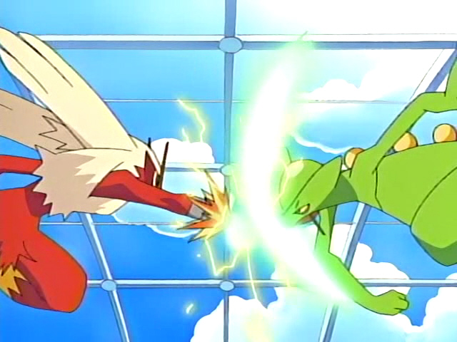
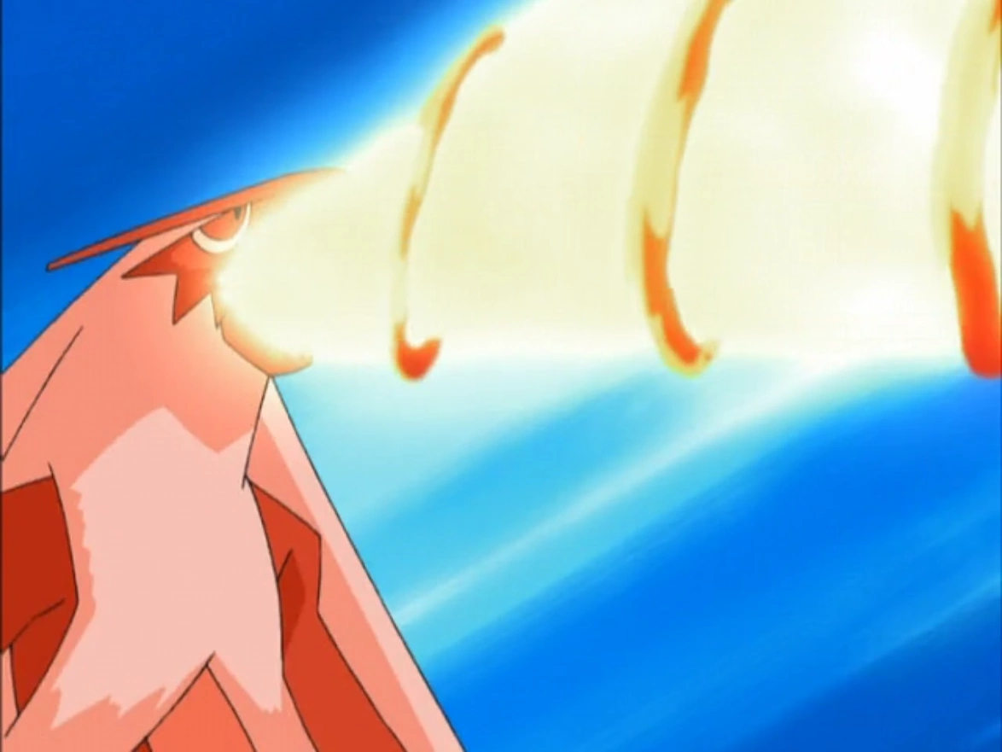
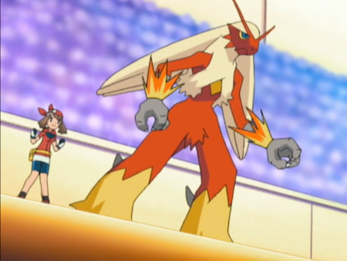
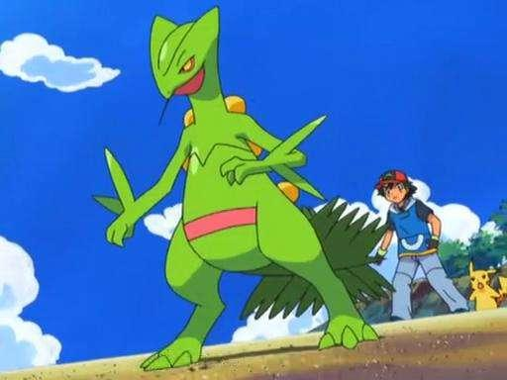
Description
13086 - Golden Ratio Overheat
Overheat

Slide 7
Description
13086 - Golden Ratio Overheat
Given two strings F₀ and F₁, for example:
F₀ = "abc", F₁ = "def".

Slide 8
Description
13086 - Golden Ratio Overheat
Given two strings F₀ and F₁, for example:
F₀ = "abc", F₁ = "def".
We can generate longer patterns with the rule F_{n-2} + F_{n-1} = F_{n}, for example:
F₂ = "abcdef",
F₃ = "defabcdef",
F₄ = "abcdefdefabcdef".

Slide 9
Description
13086 - Golden Ratio Overheat
Given two strings F₀ and F₁, for example:
F₀ = "abc", F₁ = "def".
We can generate longer patterns with the rule F_{n-2} + F_{n-1} = F_{n}, for example:
F₂ = "abcdef",
F₃ = "defabcdef",
F₄ = "abcdefdefabcdef".
Overheat
F_{n-2} + F_{n-1} = F_{n}

Slide 10
Description
13086 - Golden Ratio Overheat
Given two strings F₀ and F₁, for example:
F₀ = "abc", F₁ = "def".
We can generate longer patterns with the rule F_{n-2} + F_{n-1} = F_{n}, for example:
F₂ = "abcdef",
F₃ = "defabcdef",
F₄ = "abcdefdefabcdef".
We want to find the k-th character in F_{n}, for example:
n = 0, k = 0, output "a".
n = 2, k = 5, output "f".
F_{n-2} + F_{n-1} = F_{n}

Slide 11
I/O Format
13086 - Golden Ratio Overheat
Input
First line contains an integer T, which denotes the number of test data.
First line of each test data contains two strings F₀ and F₁.
Second line of each test data contains two integers n and k.

Slide 12
I/O Format
13086 - Golden Ratio Overheat
Input
First line contains an integer T, which denotes the number of test data.
First line of each test data contains two strings F₀ and F₁.
Second line of each test data contains two integers n and k.
1 ≦ T ≦ 100,
1 ≦ |F₀|, |F₁| ≦ 2000 (contains a-z only),
0 ≦ n < 60 and 0 ≦ k < |F_{n}|.

Slide 13
I/O Format
13086 - Golden Ratio Overheat
Input
First line contains an integer T, which denotes the number of test data.
First line of each test data contains two strings F₀ and F₁.
Second line of each test data contains two integers n and k.
1 ≦ T ≦ 100,
1 ≦ |F₀|, |F₁| ≦ 2000 (contains a-z only),
0 ≦ n < 60 and 0 ≦ k < |F_{n}|.
Output
For each test data, output the k-th character in F_{n}.

Slide 14
Idea
13086 - Golden Ratio Overheat
It’s too expensive to generate F_{n} in terms of time and space.

Slide 15
Idea
13086 - Golden Ratio Overheat
It’s too expensive to generate F_{n} in terms of time and space.
F_{n} can be decomposed to F_{n-1} and F_{n-2}, and we can determine whether the character belongs to F_{n-1} or F_{n-2} if we have the lengths of F_{n-1} and F_{n-2}.

Slide 16
Idea
13086 - Golden Ratio Overheat
It’s too expensive to generate F_{n} in terms of time and space.
F_{n} can be decomposed to F_{n-1} and F_{n-2}, and we can determine whether the character belongs to F_{n-1} or F_{n-2} if we have the lengths of F_{n-1} and F_{n-2}.
F_{n}
[0]

Slide 17
Idea
13086 - Golden Ratio Overheat
It’s too expensive to generate F_{n} in terms of time and space.
F_{n} can be decomposed to F_{n-1} and F_{n-2}, and we can determine whether the character belongs to F_{n-1} or F_{n-2} if we have the lengths of F_{n-1} and F_{n-2}.
F_{n}
F_{n-2}
F_{n-1}
[0]
[0]
[|F_{n-2}|]

Slide 18
Idea
13086 - Golden Ratio Overheat
It’s too expensive to generate F_{n} in terms of time and space.
F_{n} can be decomposed to F_{n-1} and F_{n-2}, and we can determine whether the character belongs to F_{n-1} or F_{n-2} if we have the lengths of F_{n-1} and F_{n-2}.
Use recursion to simplify the problem.
char f(int n, long long int k); // int is not enough for k
F_{n}
F_{n-2}
F_{n-1}
[0]
[0]
[|F_{n-2}|]

Slide 19
Idea - Recursive Step (1/2)
13086 - Golden Ratio Overheat
n > 1, k ≧ |F_{n-2}|
if (k >= |F_{n-2}|)
return f(n-1, k-|F_{n-2}|);
F_{n-2}
F_{n-1}
F_{n-1}
[0]
[|F_{n-2}|]
[0]
k
k-|F_{n-2}|

Slide 20
Idea - Recursive Step (2/2)
13086 - Golden Ratio Overheat
n > 1, k < |F_{n-2}|
if (k < |F_{n-2}|)
return f(n-2, k);
F_{n-2}
F_{n-1}
F_{n-2}
[0]
[|F_{n-2}|]
[0]
k
k

Slide 21
Idea - Basis Step (1/2)
13086 - Golden Ratio Overheat
n = 0
if (n == 0) return F₀[k];
F₀
k

Slide 22
Idea - Basis Step (2/2)
13086 - Golden Ratio Overheat
n = 1
if (n == 1) return F₁[k];
F₁
k

Slide 23
Code
13086 - Golden Ratio Overheat
#include <stdio.h>
#include <stdlib.h>
#include <string.h>
char f0[2020], f1[2020];
long long int len[100];
char f(int n, long long int k) {
}
// basis step
if (n == 0) return f0[k];
if (n == 1) return f1[k];
// recursive step
if (k >= len[n-2]) return f(n-1, k-len[n-2]);
else return f(n-2, k);
int main() {
}
int T;
scanf("%d", &T);
while (T--) {
}
long long int n, k;
scanf("%s %s %lld %lld", f0, f1, &n, &k);
// get the lengths of F0, F1.
len[0] = strlen(f0), len[1] = strlen(f1);
// calculate the lengths of F2, ..., Fn.
for (int i = 2; i <= n; i++)
len[i] = len[i-1] + len[i-2];
char ans = f(n, k);
printf("%c\n", ans);

Slide 24
The End
Feel free to contact us, if needed :)

